Slide 1

Jesus Said, “You Do Err Not Knowing the Scripture”
Matthew 22:29

Slide 2
Matthew 22:29 (KJV)
Jesus answered and said unto them, Ye do err, not knowing the scriptures, nor the power of God.

Slide 3
Matthew 22:23-32 (KJV)
²³ The same day came to him the Sadducees, which say that there is no resurrection, and asked him, ²⁴ Saying, Master, Moses said, If a man die, having no children, his brother shall marry his wife, and raise up seed unto his brother.

Slide 4
Matthew 22:23-32 (KJV)
²⁵ Now there were with us seven brethren: and the first, when he had married a wife, deceased, and, having no issue, left his wife unto his brother: ²⁶ Likewise the second also, and the third, unto the seventh.

Slide 5
Matthew 22:23-32 (KJV)
²⁷ And last of all the woman died also. ²⁸ Therefore in the resurrection whose wife shall she be of the seven? for they all had her. ²⁹ Jesus answered and said unto them, Ye do err, not knowing the scriptures, nor the power of God.

Slide 6
Matthew 22:23-32 (KJV)
³⁰ For in the resurrection they neither marry, nor are given in marriage, but are as the angels of God in heaven. ³¹ But as touching the resurrection of the dead, have ye not read that which was spoken unto you by God, saying,

Slide 7
Matthew 22:23-32 (KJV)
³² I am the God of Abraham, and the God of Isaac, and the God of Jacob? God is not the God of the dead, but of the living.

Slide 8
GOD’S word is perfect, no errors, no grey areas, no private interpretations. From the book of Genesis to the book of Revelation we read of man adding to; taking words out of; and twisting the scriptures to his own destruction, burning in Hell forever, for not obeying the written word of GOD.

Slide 9
Who told you to be a Mormon?
Genesis 3:11 (KJV)
And he said, Who told thee that thou wast naked? Hast thou eaten of the tree, whereof I commanded thee that thou shouldest not eat?

Slide 10
Twist the Word of GOD
II Peter 3:16 (KJV)
As also in all his epistles, speaking in them of these things; in which are some things hard to be understood,

Slide 11
II Peter 3:16 (KJV)
which they that are unlearned and unstable wrest, as they do also the other scriptures, unto their own destruction.

Slide 12
Satan and His Ministers
II Corinthians 11:14-15 (KJV)
¹⁴ And no marvel; for Satan himself is transformed into an angel of light. ¹⁵ Therefore it is no great thing if his ministers also be transformed as the ministers of righteousness;

Slide 13
II Corinthians 11:14-15 (KJV)
whose end shall be according to their works

Slide 14
Abide in the doctrine of CHRIST II John 9-10 (KJV)
⁹ Whosoever transgresseth, and abideth not in the doctrine of Christ, hath not God. He that abideth in the doctrine of Christ, he hath both the Father and the Son.

Slide 15
II John 9-10 (KJV)
¹⁰ If there come any unto you, and bring not this doctrine, receive him not into your house, neither bid him God speed:

Slide 16
What Kind of Music Does GOD Want in Worship, in Christ’s Church?
Does God Know How to Say Play an Instrument?
God Said, Take Away the Sound of the Instrument From ME
How Not to Err in Obeying GOD’S Word

Slide 17
Point #1: What Kind of Music Does GOD Want in Worship, in Christ’s Church?
Eph 5:19 (KJV)
Col 3:16 (KJV)
Heb 2:12 (KJV)
Heb 3:15 (KJV)
Matt 26:30 (KJV)
James 5:13 (KJV)
Rom 15:9 (KJV)
Acts 16:26 (KJV)
I Cor 14:16 (KJV)

Slide 18
Ephesians 5:19 (KJV)
Speaking to yourselves in psalms and hymns and spiritual songs, singing and making melody in your heart to the Lord;

Slide 19
Colossians 3:16 (KJV)
Let the word of Christ dwell in you richly in all wisdom; teaching and admonishing one another in psalms and hymns and spiritual songs, singing with grace in your hearts to the Lord.

Slide 20
Hebrews 2:12 (KJV)
Saying, I will declare thy name unto my brethren, in the midst of the church will I sing praise unto thee.

Slide 21
Hebrews 13:15 (KJV)
By him therefore let us offer the sacrifice of praise to God continually, that is, the fruit of our lips giving thanks to his name.

Slide 22
Matthew 26:30 (KJV)
And when they had sung an hymn, they went out into the mount of Olives.

Slide 23
James 5:13 (KJV)
Is any among you afflicted? let him pray. Is any merry? let him sing psalms.

Slide 24
Romans 15:9 (KJV)
And that the Gentiles might glorify God for his mercy; as it is written, For this cause I will confess to thee among the Gentiles, and sing unto thy name.

Slide 25
Acts 16:25 (KJV)
And at midnight Paul and Silas prayed, and sang praises unto God: and the prisoners heard them.

Slide 26
I Corinthians 14:15 (KJV)
What is it then? I will pray with the spirit, and I will pray with the understanding also: I will sing with the spirit, and I will sing with the understanding also.

Slide 27
Point #2: Does God Know How to Say
Play an Instrument?
Psalms 150:1-6 (KJV)

Slide 28
Psalms 150:1-6 (KJV)
¹ Praise ye the Lord. Praise God in his sanctuary: praise him in the firmament of his power.
² Praise him for his mighty acts: praise him according to his excellent greatness.

Slide 29
Psalms 150:1-6 (KJV)
³ Praise him with the sound of the trumpet: praise him with the psaltery and harp.
⁴ Praise him with the timbrel and dance: praise him with stringed instruments and organs.

Slide 30
Psalms 150:1-6 (KJV)
⁵ Praise him upon the loud cymbals: praise him upon the high sounding cymbals.
⁶ Let every thing that hath breath praise the Lord. Praise ye the Lord.

Slide 31
Point #3: God Said, Take Away the Sound of the Instrument From ME
Amos 5:23 (KJV/NASB)
Amos 6:1-5 (KJV)

Slide 32
Amos 5:23 (KJV)
Take thou away from me the noise of thy songs; for I will not hear the melody of thy viols.

Slide 33
Amos 5:23 (NASB)
Take away from Me the noise of your songs; I will not even listen to the sound of your harps.

Slide 34
Amos 6:1-5 (KJV)
¹ Woe to them that are at ease in Zion, and trust in the mountain of Samaria, which are named chief of the nations, to whom the house of Israel came!

Slide 35
Amos 6:1-5 (KJV)
² Pass ye unto Calneh, and see; and from thence go ye to Hamath the great: then go down to Gath of the Philistines: be they better than these kingdoms? or their border greater than your border?

Slide 36
Amos 6:1-5 (KJV)
³ Ye that put far away the evil day, and cause the seat of violence to come near;
⁴ That lie upon beds of ivory, and stretch themselves upon their couches,

Slide 37
Amos 6:1-5 (KJV)
and eat the lambs out of the flock, and the calves out of the midst of the stall;
⁵ That chant to the sound of the viol, and invent to themselves instruments of musick, like David;

Slide 38
Point #4: How Not to Err in Obeying GOD’S Word
Believe the Word of GOD is Perfect, Written by the HOLY SPIRIT
Read the Word Daily
Study the Word Rightly Dividing the Scriptures

Slide 39
Point #4: How Not to Err in Obeying GOD’S Word
Do Not Add or Take Away From What is Written
Trust GOD and Lean Not to Your Own Understanding

Slide 40
II Peter 1:20-21 (KJV)
²⁰ Knowing this first, that no prophecy of the scripture is of any private interpretation. ²¹ For the prophecy came not in old time by the will of man: but holy men of God spake as they were moved by the Holy Ghost.

Slide 41
Luke 9:23 (KJV)
And he said to them all, If any man will come after me, let him deny himself, and take up his cross daily, and follow me.

Slide 42
II Timothy 2:15 (KJV)
And he said to them all, If any man will come after me, let him deny himself, and take up his cross daily, and follow me.

Slide 43
Deuteronomy 4:2 (KJV)
Ye shall not add unto the word which I command you, neither shall ye diminish ought from it, that ye may keep the commandments of the Lord your God which I command you.

Slide 44
Proverbs 30:5-6 (KJV)
⁵ Every word of God is pure: he is a shield unto them that put their trust in him.
⁶ Add thou not unto his words, lest he reprove thee, and thou be found a liar.

Slide 45
Revelation 22:18-19 (KJV)
¹⁸ For I testify unto every man that heareth the words of the prophecy of this book, If any man shall add unto these things, God shall add unto him the plagues that are written in this book:

Slide 46
Revelation 22:18-19 (KJV)
¹⁹ And if any man shall take away from the words of the book of this prophecy, God shall take away his part out of the book of life, and out of the holy city, and from the things which are written in this book.

Slide 47
Proverbs 3:5-7 (KJV)
⁵ Trust in the Lord with all thine heart; and lean not unto thine own understanding.
⁶ In all thy ways acknowledge him, and he shall direct thy paths.

Slide 48
Proverbs 3:5-7 (KJV)
⁷ Be not wise in thine own eyes: fear the Lord, and depart from evil.

Slide 49
ARE YOU FOLLOWING RELIGIOUS ERROR TODAY?

Slide 50
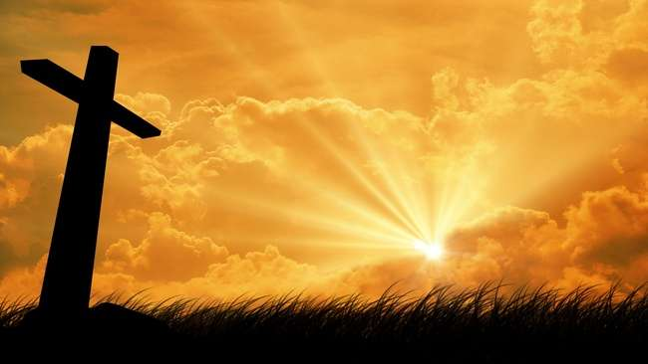
…that Christ died for our sins according to the scriptures;
And that he was buried, and that he rose again the third day according to the scriptures:

Slide 51
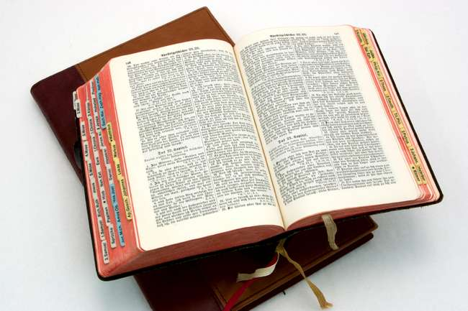
Hear: Romans 10:17
So then faith cometh by hearing, and hearing by the word of God.

Slide 52
Believe: Hebrews 11:6
But without faith it is impossible to please him: for he that cometh to God must believe that he is, and that he is a rewarder of them that diligently seek him.

Slide 53
Repent: Luke 13:3
I tell you, Nay: but, except ye repent, ye shall all likewise perish.

Slide 54
Confess: Matthew 10:32-33
32 Whosoever therefore shall confess me before men, him will I confess also before my Father which is in heaven.
33 But whosoever shall deny me before men, him will I also deny before my Father which is in heaven.

Slide 55
Baptize: Acts 22:16
And now why tarriest thou? arise, and be baptized, and wash away thy sins, calling on the name of the Lord.

